Slide 1

Super Store Sales Analysis
Analyzing the retail company's data to explore a few questions regarding sales.
Tools used: Excel

Slide 2

Agenda
The Dataset
Questions & Recommendations
Final Words

Slide 3
The Dataset
The dataset was taken for Tableau. It is a Excel spreadsheet containing data of a superstore retail company. You can view the dataset here: https://community.tableau.com/s/question/0D54T00000CWeX8SAL/sample-superstore-sales-excelxls
This dataset contains 9994 customers of the company.

Slide 4
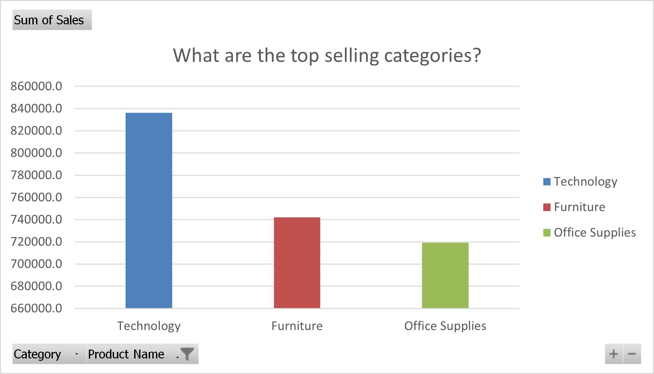
What are the top selling categories?
The top selling category is Technology products. There is a high demand for products in these category. Therefore, I would recommend increasing the stock for these products.
Further analysis needs to be done to find out why furniture and office supplies is so far behind in sales performance compared to technology products.

Slide 5
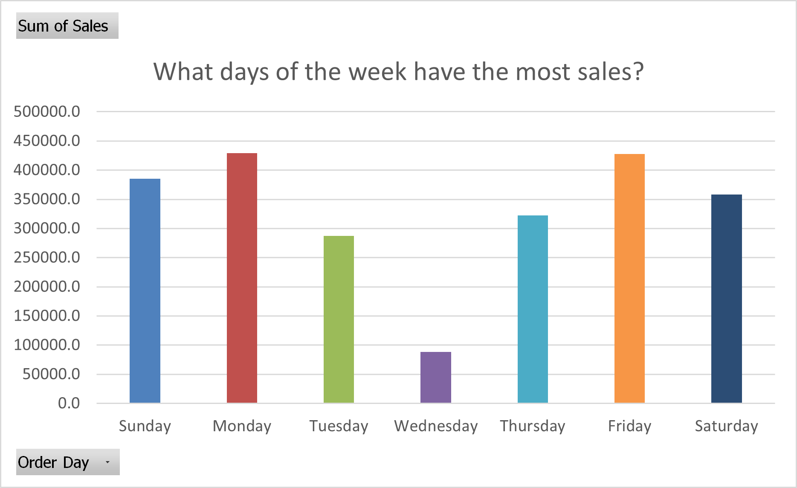
What days generate the most sales?
I discovered that while sales are fairly even throughout the week, there is a huge underperformance on Wednesday. Further analysis needs to be done to find out why. There could be several reasons. For example, are customers just not visiting the store that day?
I would recommend marketing strategies being implemented on that particular day and also have various promotions or discounts being ran on a Wednesday to increase sales for that particular day.

Slide 6
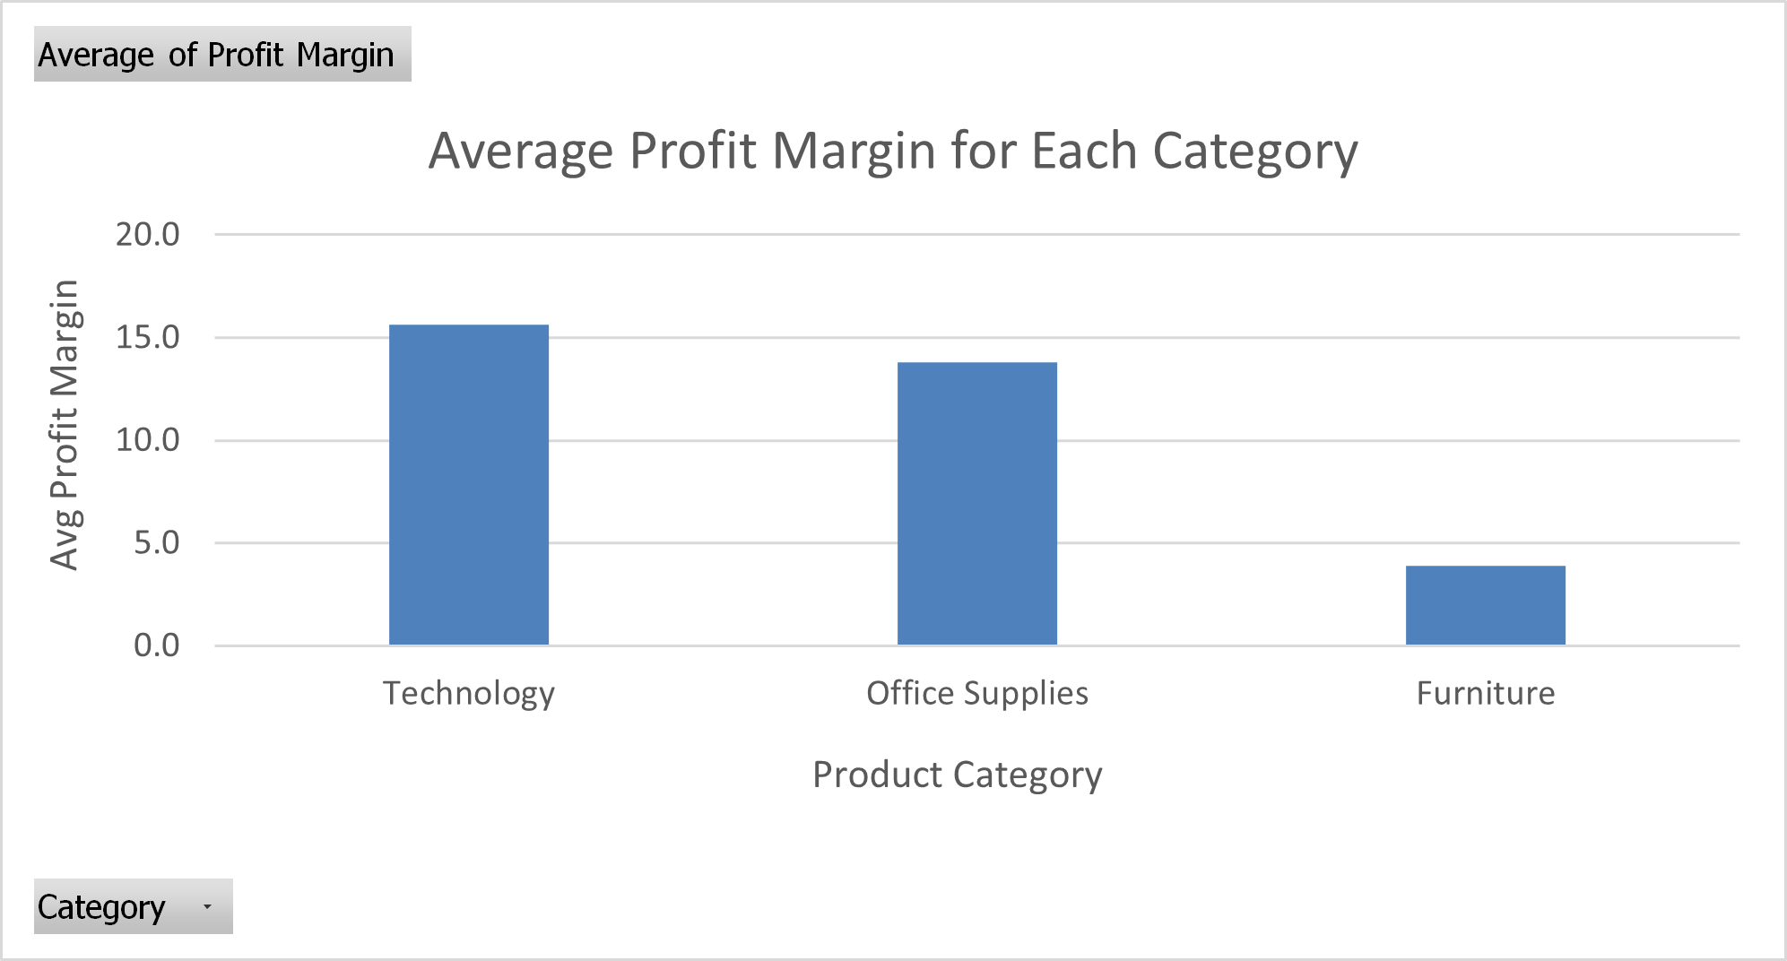
What is the average profit margin for each product category?
Technology product category has the highest average profit margin out of all three categories with a margin of 15.6, followed by 13.8 for office supplies and 3.9 for furniture. The company is making the most profit from selling technology products.
Based on these insights, I would recommend to keep focusing on technology products as it is selling well. On the other hand, I recommend revising inventory for furniture products and reducing the amount of furniture products in the inventory.
Additionally, further analysis was made to find out which products in particular in the furniture product category, that is not performing well. The three furniture products with the least total sales are: Guest Stacker Chair, Bush Advantage Conference Table and Chromcraft Bull Nose Table and Base. I recommend either discontinuing these products or reducing their quantity. We could also reduce the cost to make these products, or we could also remake these products and tailor them towards customer's needs.

Slide 7
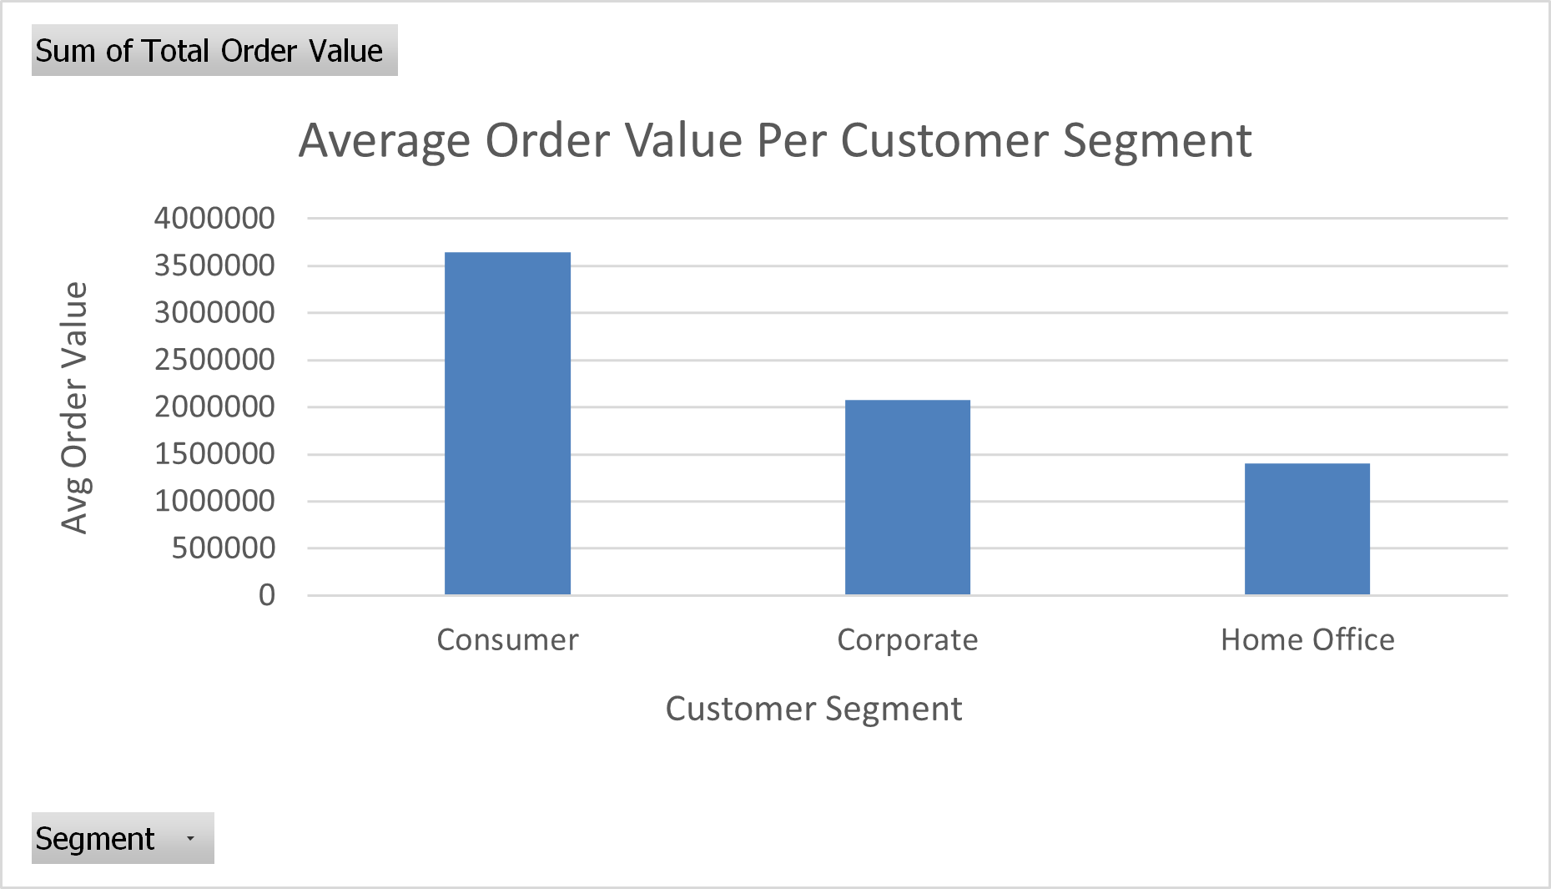
How does average order value vary by customer segment?
Based on the visualization, consumer segment has the highest average order value, followed by corporate and then home office. Consumers are spending the most money. This is no surprise because consumers usually purchase higher-priced items. The company could take the consumer spending even further by providing incentives to encourage them to spend even more and on more expensive items.
To improve the home office segment, I recommend the company to encourage bulk purchases.

Slide 8
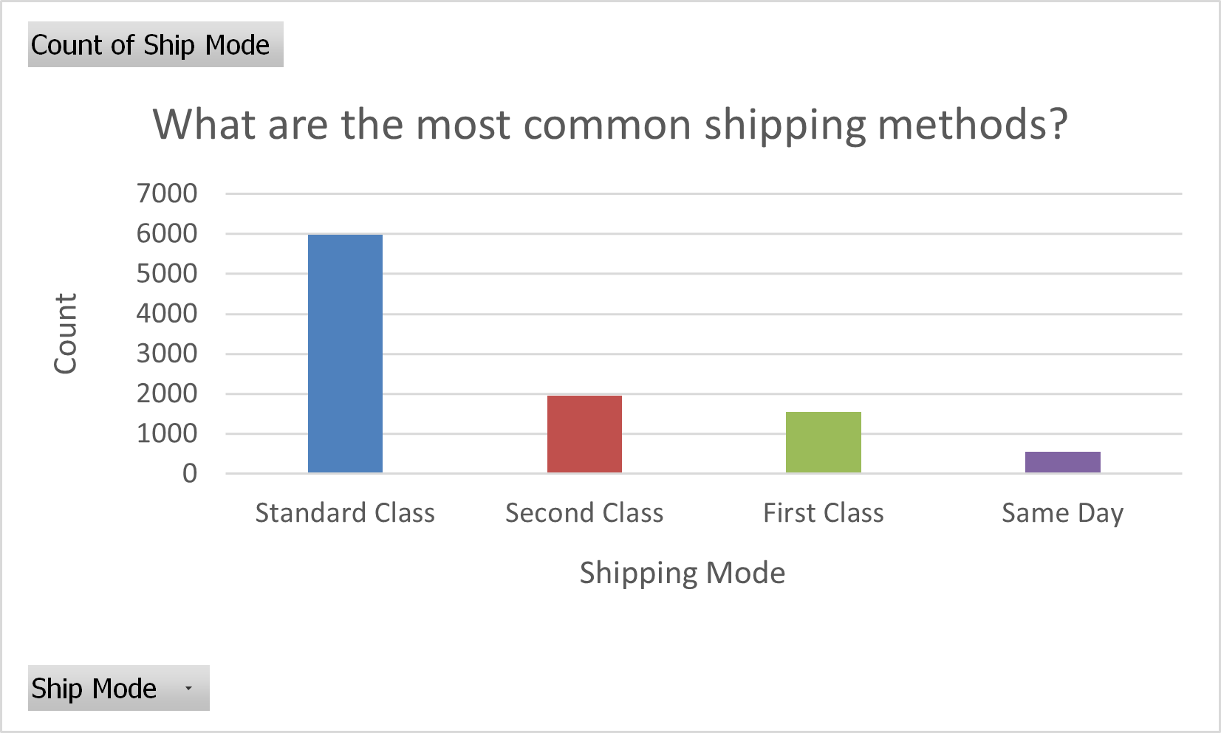
What are the most common shipping methods?
The most common shipping method is standard class. Based on this insight, it seems customers do not have any issue with waiting a few days to get their shipment. I find this surprising. I assumed same day would be the most common.
I would evaluate the same day shipping method to see if it is in-demand or not. If it is in-demand, then I would suggest ensuring customers are actually getting their packages same day because it is definitely not a popular option so something could be wrong. However, if it is not in-demand, it is probably not worth it for the company to waste resources to offer this shipping option.

Slide 9
Final Words
There is a lot of analysis that come out of this dataset.
Further analysis could be made to find out the return rate of the company, the customer retention rate for each region and how average order value vary by region and other factors in the data.
Lastly, further analysis could be made to figure out the most common shipping mode for products in the furniture category to see if processing times could be affecting the category's sales.

Slide 10
Contact Me
Email: tahjgordon22@gmail.com
Website: tajato.github.io/me
Tools Used: Excel

